Slide 1



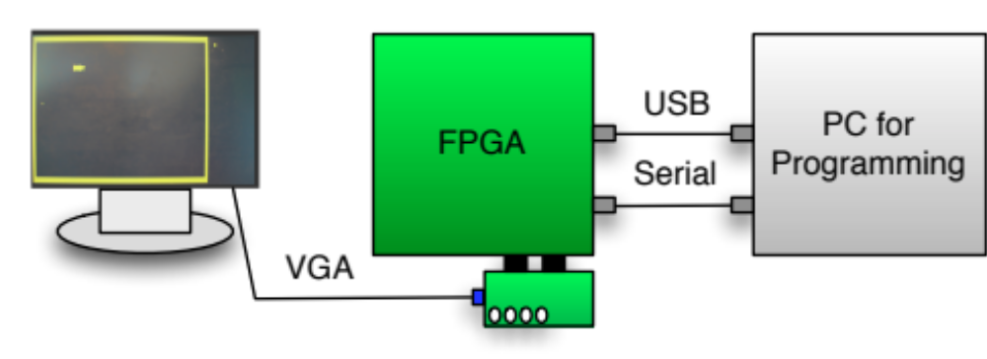
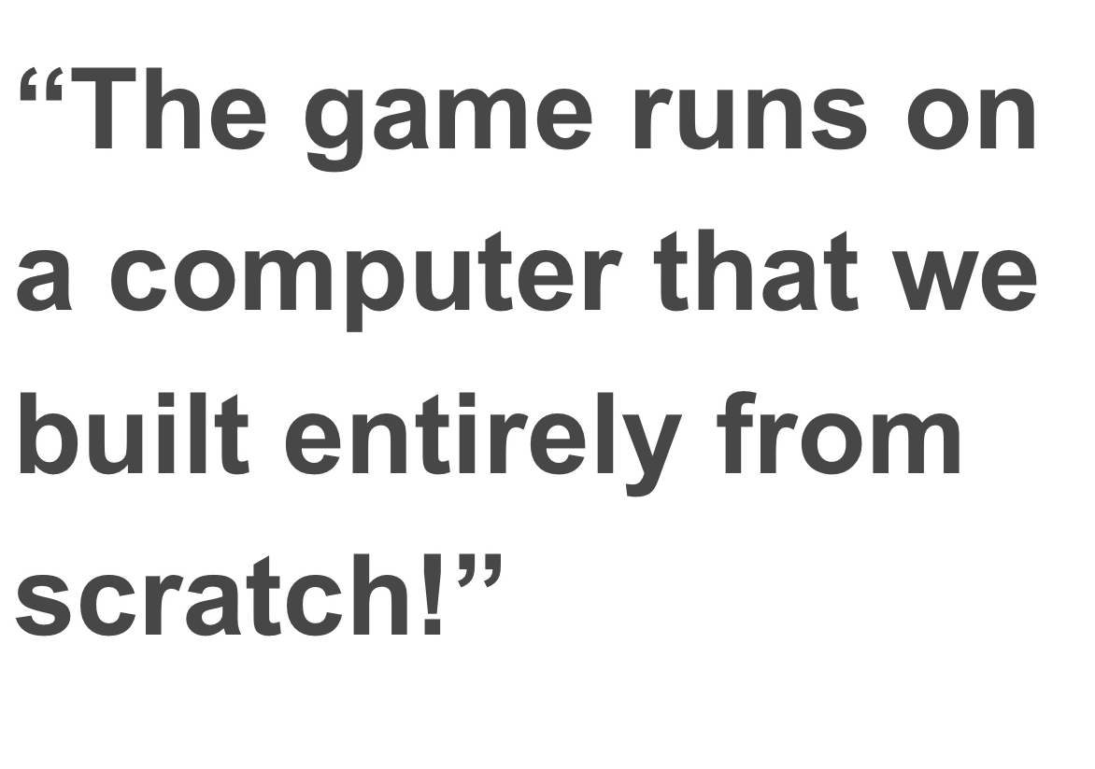
Project Description
System Description
Results
This project will cover the implementation of the LC-3 computer and I/O controllers on an FPGA-board.
For testing and verification of the CPU, the classic game Snake is developed to run on it.
The snake game should support the basic game logic, such as growth and food consumption.
Our goal has been to implement all aspects of the computer and the game on the FPGA-board so no help was needed by additional computer resources.
It should be possible to play the game only with the FPGA-board and a monitor.
The system needed to play the game consists only of the FPGA-board running the LC-3 CPU and the monitor connected to it.
The buttons on the DIO4-board is used to control the snake and navigate through the level.
The PC is only used for programming of the FPGA with the LC-3 components and the Snake game, and for receiving the scores.
The result of the project is a functional implementation of the LC-3 computer on the FPGA-board that uses:
UART
Customized tile display
Leds
Seven segment display
Switches
Buttons
The computer runs a minimal, but definitely playable implementation of the snake game.
Conclusion
The LC-3 computer is functional and implements major features needed to build the snake game. The LC-3 has been very stable platform for our usage during the development process.
The hardware game model works well and simplifies the game logic, bookkeeping and game consistency.
- Thank you for reading!
The software is implemented in a very generic and modular way, so that it can basically act as a template for other basic tile based games like Tetris and Breakout for instance.
The game features a hardware game model that maps the video memory location in a software based tile map. This eliminates the bookkeeping that otherwise would be needed to synchronize the software and the hardware model.
The game logic includes movement, snake growth, food consumption, score and death by collision with wall or snake body.
Hardware / Software Programming
Course : 02321 January 2011
Made by
Morten Hillebo & Kim Rostgaard

